Slide 1
Vibe Coding
Codex

Slide 2
Create new UI with google stitch
Design a complete modern e-commerce web app UI similar to Shopee or Lazada. Include the following screens:
1. **Homepage** – sticky top navbar with logo, search bar, cart icon, and user avatar. Below: hero banner carousel, category icons grid (Electronics, Fashion, Food, Beauty, etc.), flash sale section with countdown timer, product grid with rating stars and discount badges.
2. **Product Listing Page** – filter sidebar (category, price range, rating, brand), sort dropdown, responsive product card grid (image, name, price, original price strikethrough, % off badge, sold count).
3. **Product Detail Page** – image gallery with thumbnails, product title, star rating + review count, price highlight in orange/red, quantity selector, "Add to Cart" and "Buy Now" CTA buttons, seller info card, tabbed section (Description / Reviews / Specs).
4. **Shopping Cart Page** – item list with checkbox select-all, quantity stepper, remove button, order summary card with subtotal, shipping fee, discount, and total. Sticky "Checkout" button.
5. **Checkout Page** – delivery address section, payment method selector (COD, card, e-wallet), order summary, promo code input, place order button.
6. **User Profile / Dashboard** – avatar, name, stats (orders, reviews, vouchers), tabs for My Orders (with status chips: Pending / Shipping / Delivered / Cancelled).
**Design style:**
- Modern, clean, mobile-first but also desktop-friendly
- Primary color: coral orange (#EE4D2D) like Shopee, or electric blue
- White background, light gray cards, rounded corners (12–16px)
- Bold typography for prices, subtle shadows on cards
- Micro-interactions: hover states, badge animations, skeleton loaders shown as placeholders
- Vietnamese locale: prices in ₫ (VND), labels in Vietnamese optional
Output all screens as high-fidelity UI mockups ready for developer handoff.

Slide 3
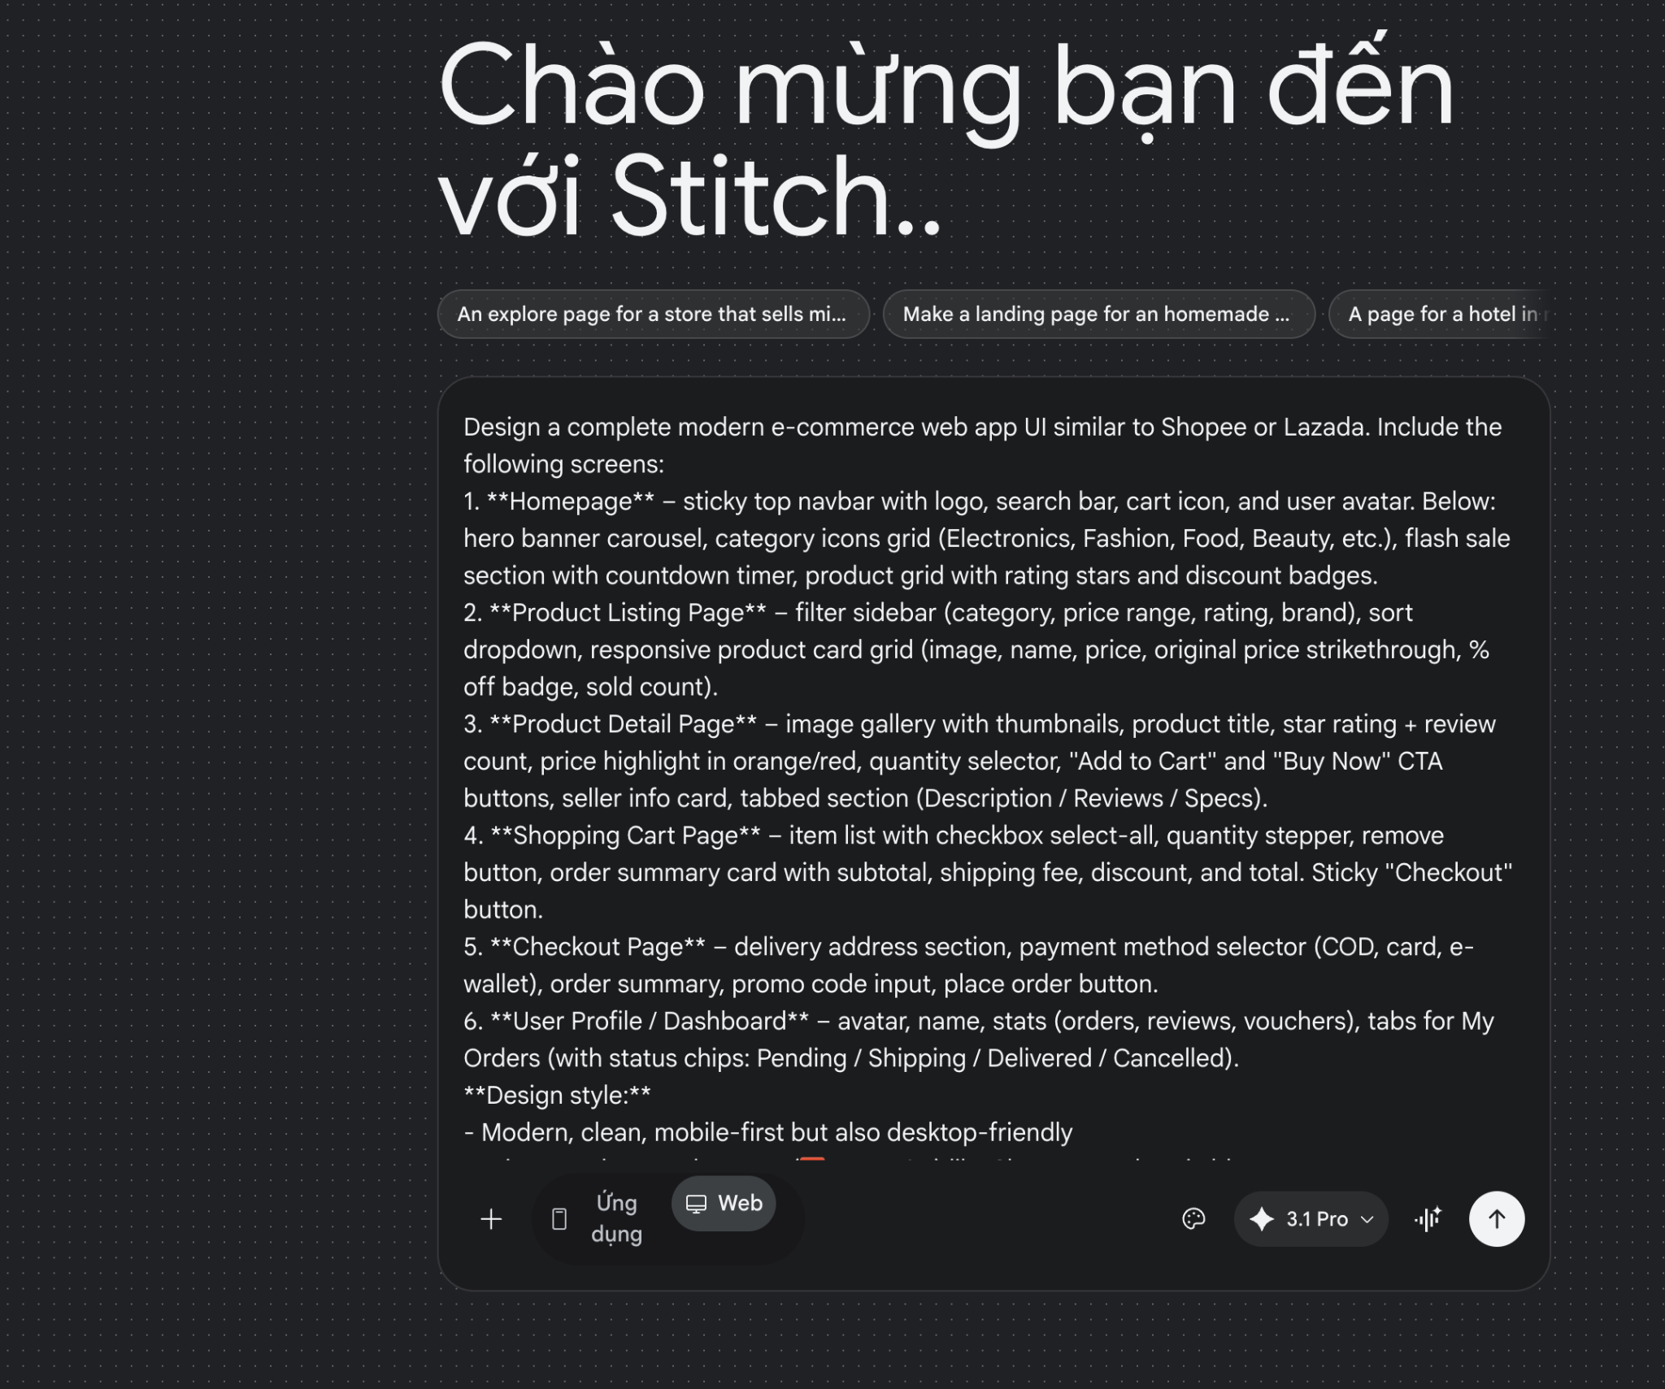

Slide 4
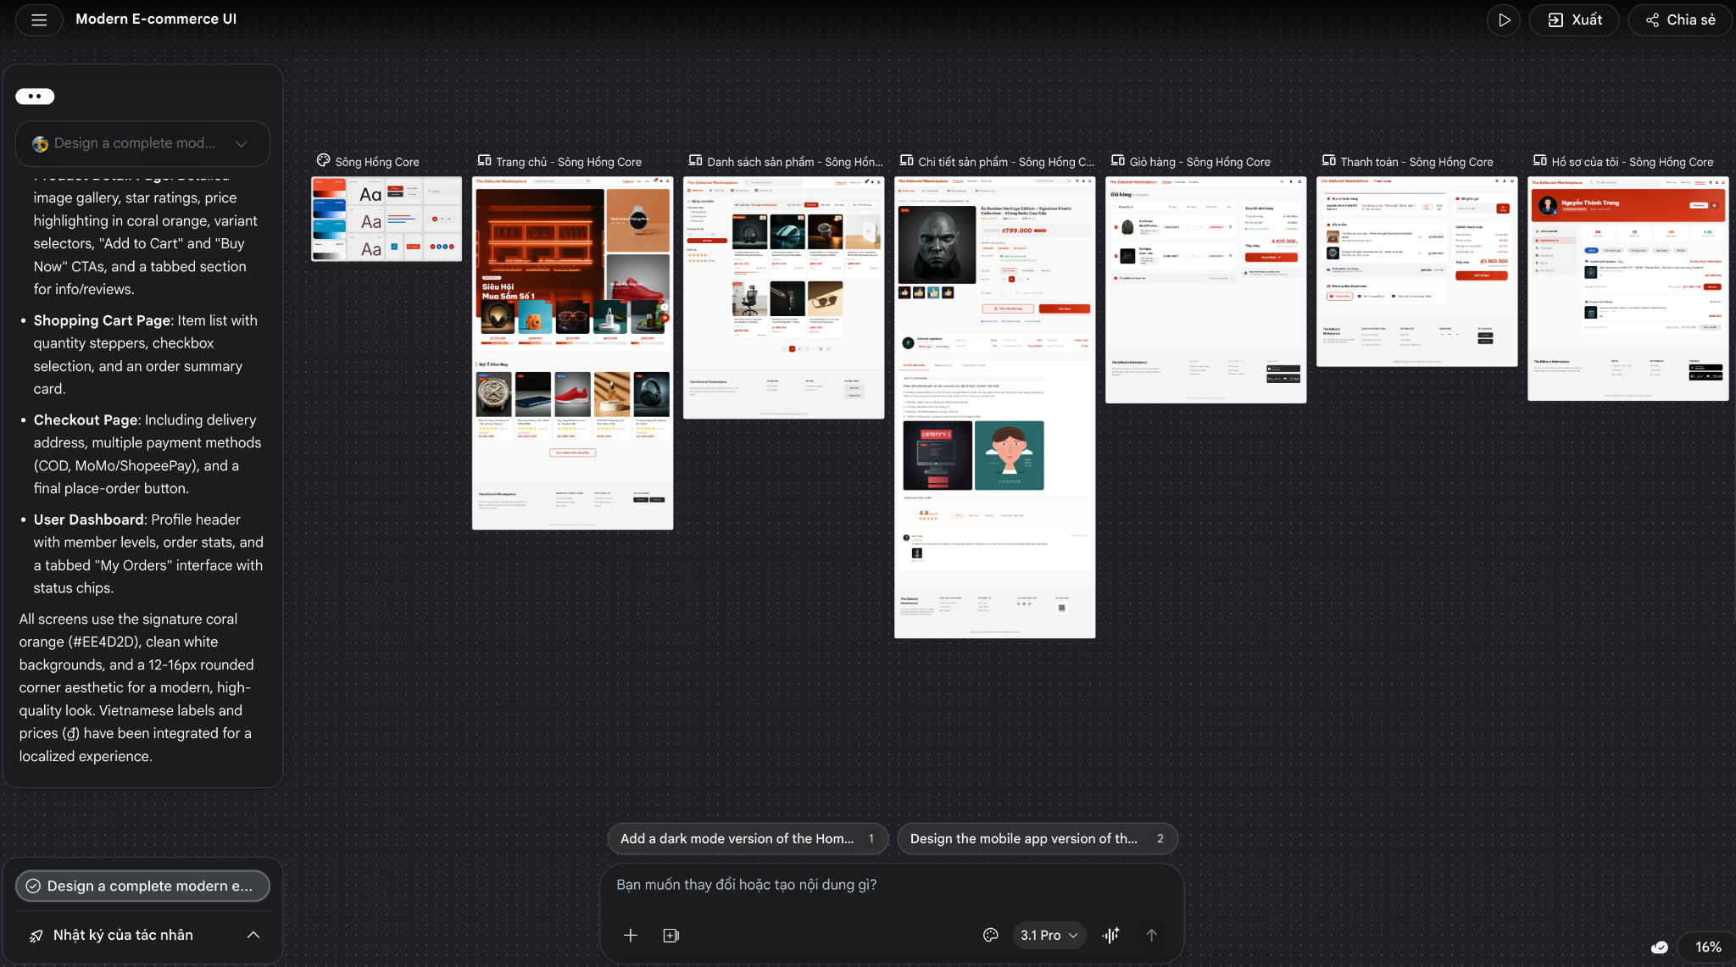

Slide 5
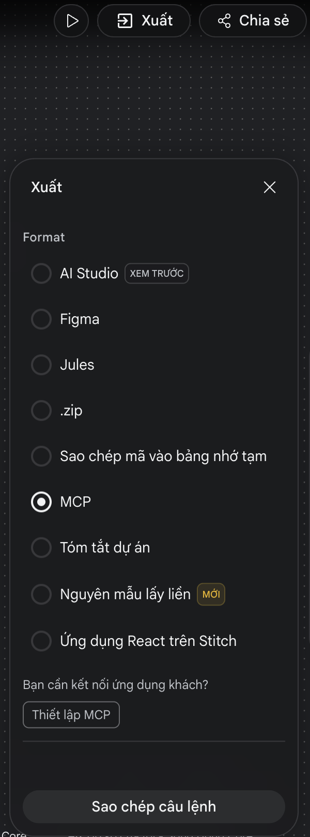
Export generated UI to agent via MCP:

Slide 6
Code with Codex: prompt
Create website with following design with:
- database: postgres
- BE + FE: Typescripts + framework.
## Stitch Instructions
Get the images and code for the following Stitch project's screens:
## Project
Title: Modern E-commerce UI
ID: 1994126963491177429
## Screens:
1. Design System
ID: asset-stub-assets-af21b6f454254fcd8195194aa0e5d893-1775448990971
2. Danh sách sản phẩm - Sông Hồng Core
ID: 3da82f90adb1400882153a0f7fdc6017
3. Thanh toán - Sông Hồng Core
ID: 65787d143b654bbcbf67d399a4f91e76
4. Hồ sơ của tôi - Sông Hồng Core
ID: 831b55c92c0d44a994ea8a99b6fe4dd8
5. Giỏ hàng - Sông Hồng Core
ID: bd5867b5e8f0471695ad888f7b29dd71
6. Trang chủ - Sông Hồng Core
ID: e31b80252a6e43bfba7c7e1e6a23ebc1
7. Chi tiết sản phẩm - Sông Hồng Core
ID: e8f3225c7e4642c8b35f631db145b432
Use a utility like `curl -L` to download the hosted URLs.

Slide 7
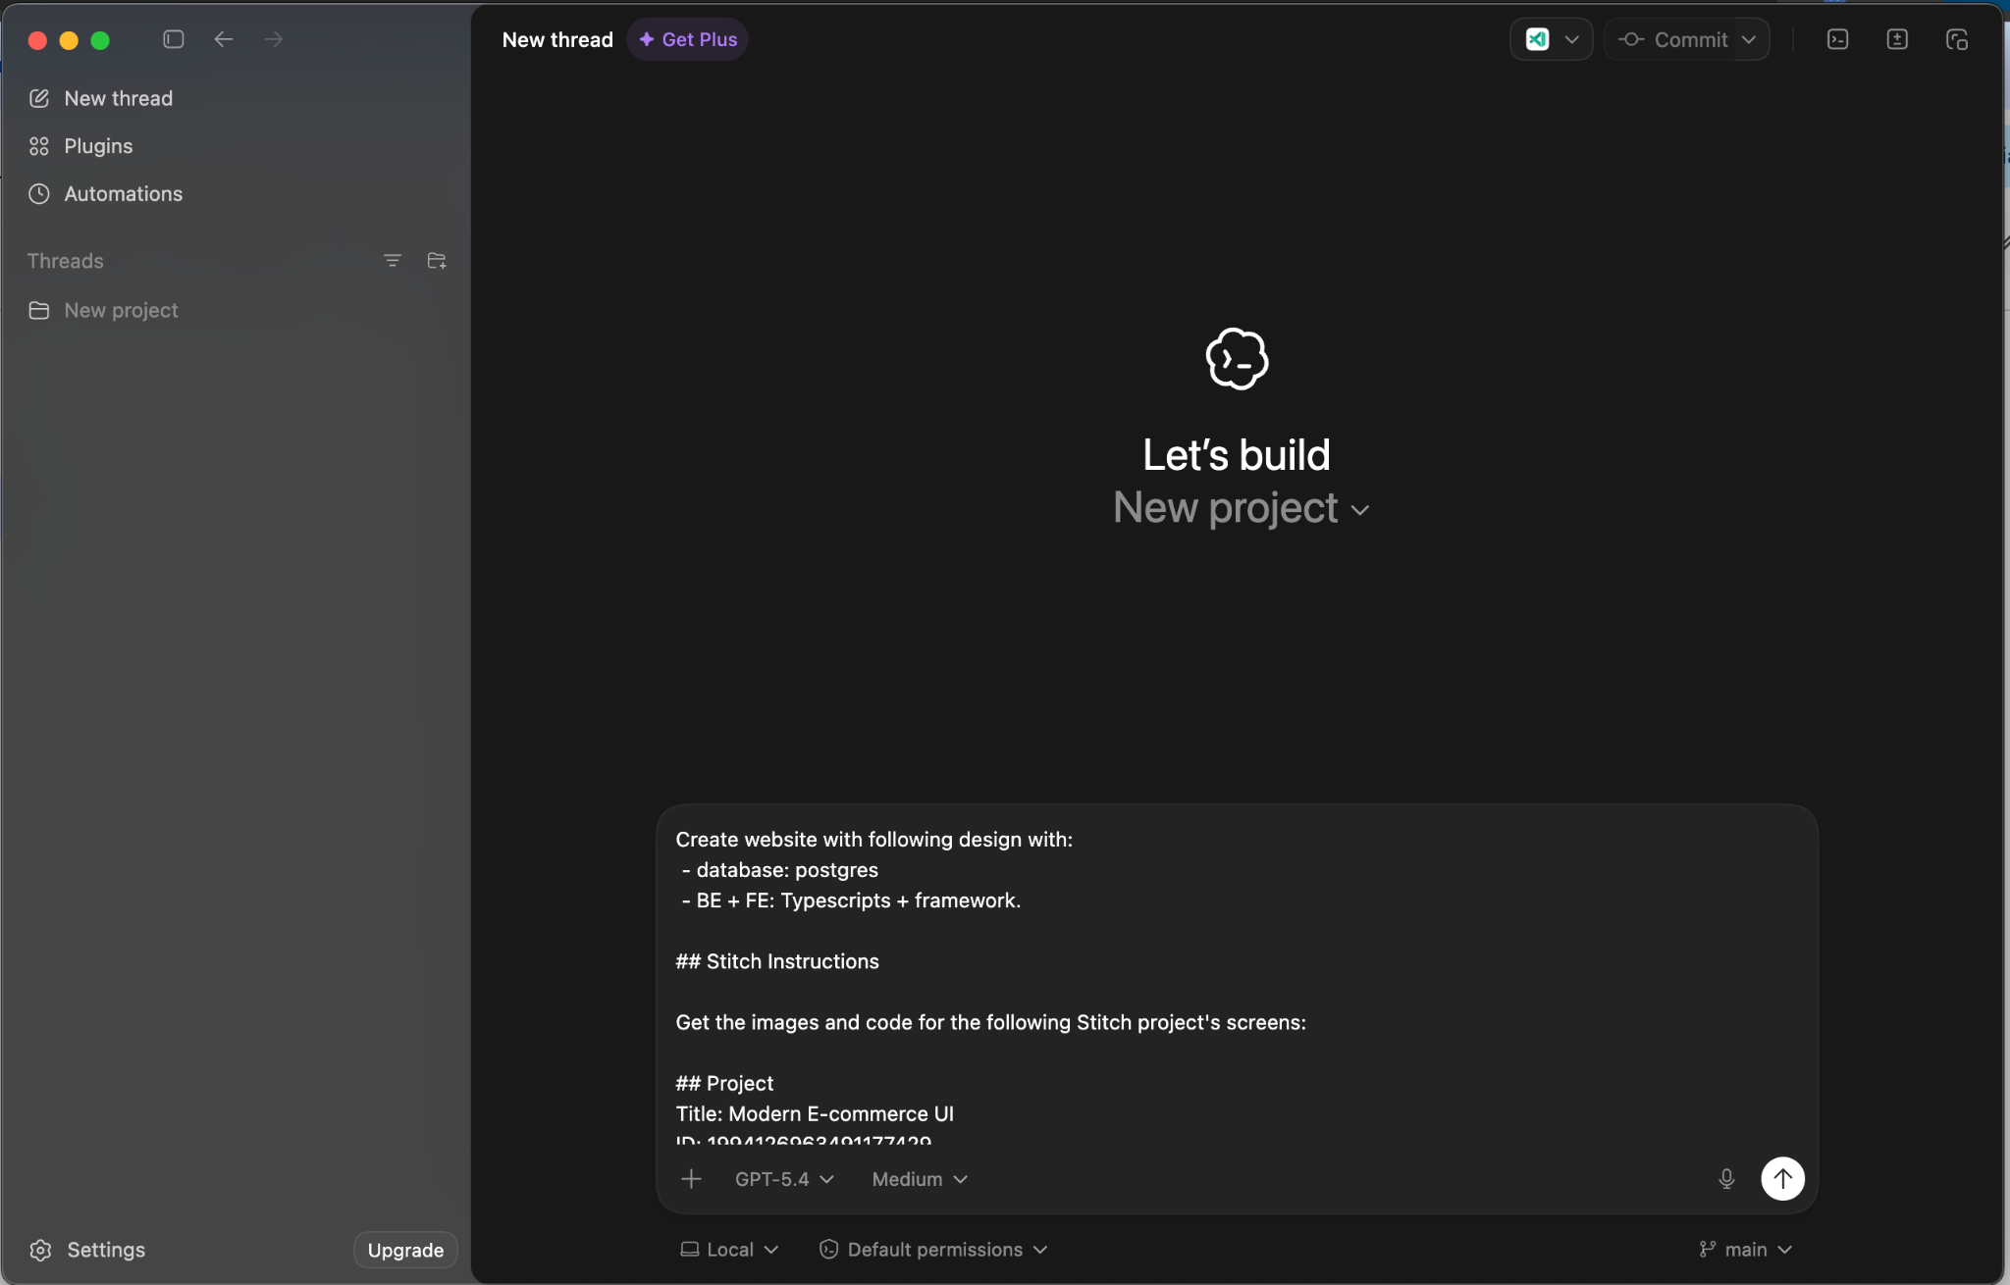

Slide 8
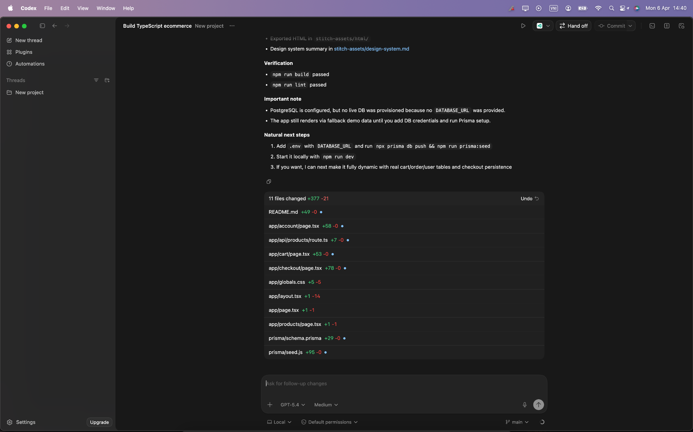

Slide 9
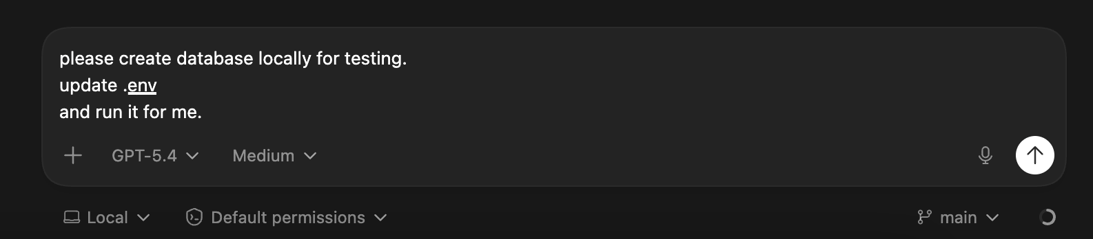
Config database
please create database locally for testing.
update .env
and run it for me.

Slide 10
Config payment: prompt
sao chữ k có dấu z?
giỏ hàng thanh toán xong cũng k xoá. sản phẩm k phải real từ database.
thêm thanh toán trực tiếp bằng
# ── Stripe (test keys) ────────────────────────────────────────────────────────
# Get yours free at https://dashboard.stripe.com/test/apikeys
STRIPE_SECRET_KEY=sk_test_51TEM8rKyG9Uxc8ud7gyrwZzDracbwejGkySWEMGZwNOWDkcff3eC3v58T35IPni2ap0mDce0a7fub7tOS7C7X7yl00wT0grFhk
STRIPE_WEBHOOK_SECRET=whsec_placeholder
STRIPE_PUBLISHABLE_KEY=pk_test_51TEM8rKyG9Uxc8udzT4ar2Z2yaXDIVDYBOVUSEi7TqgB4GDzFJJzagsE6YQjOSsJRNoJ4R0zAKpSBVq8kkVQJdOx00cnloEMxH

Slide 11
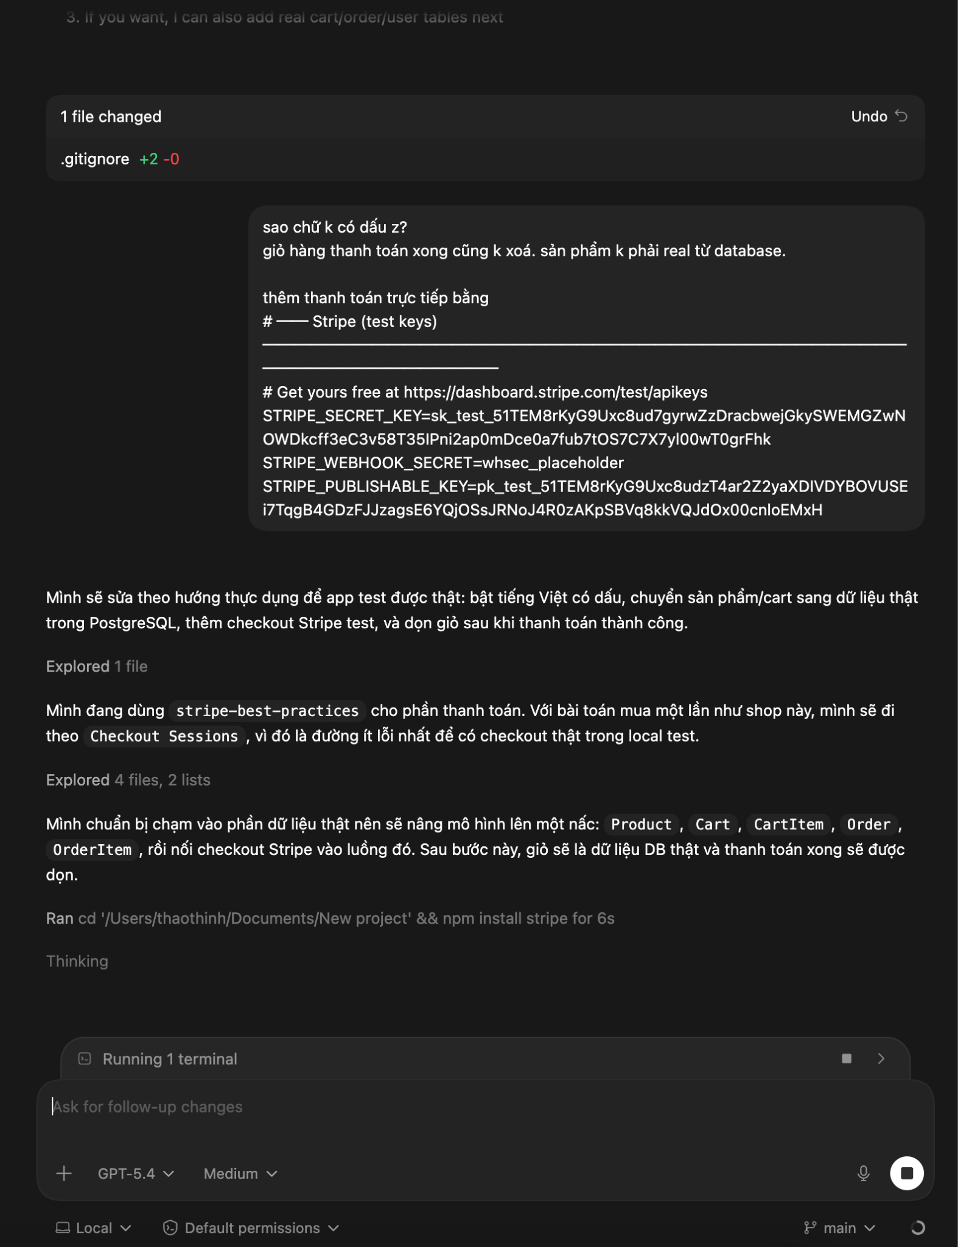

Slide 12
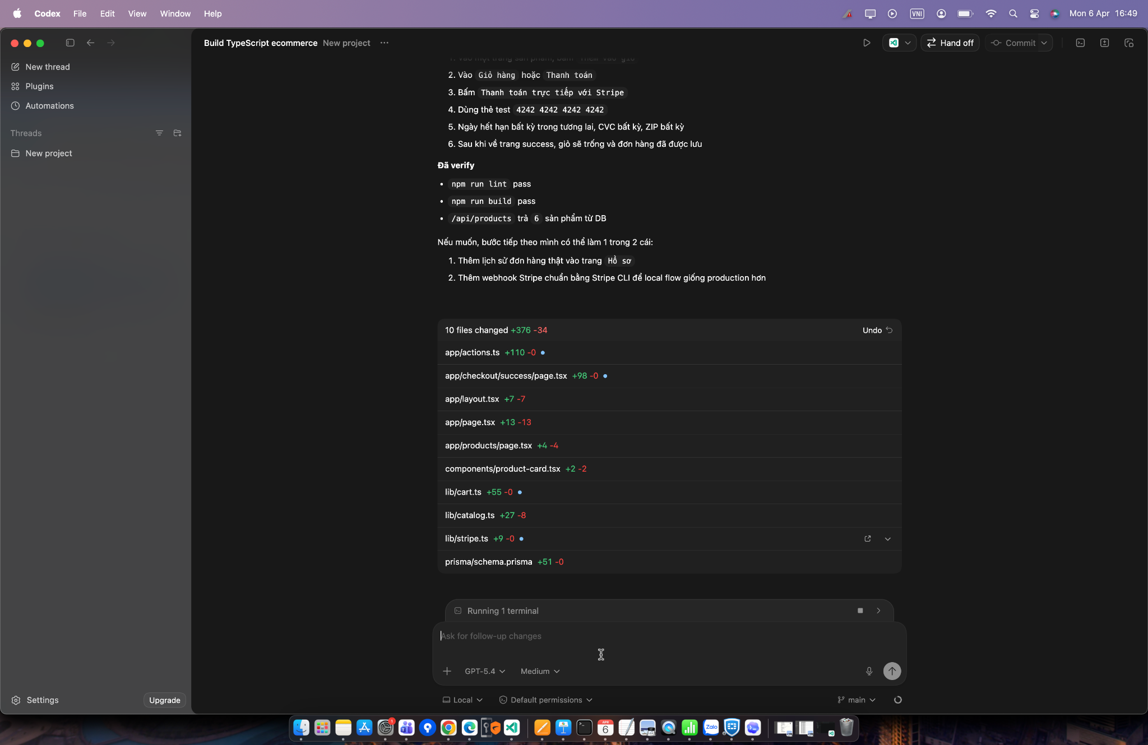

Slide 13
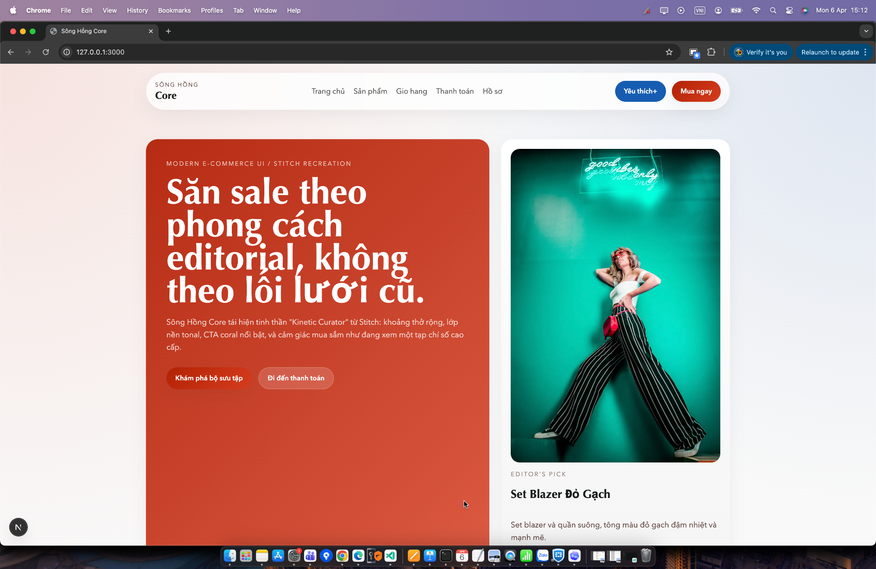
Demo:

Slide 14
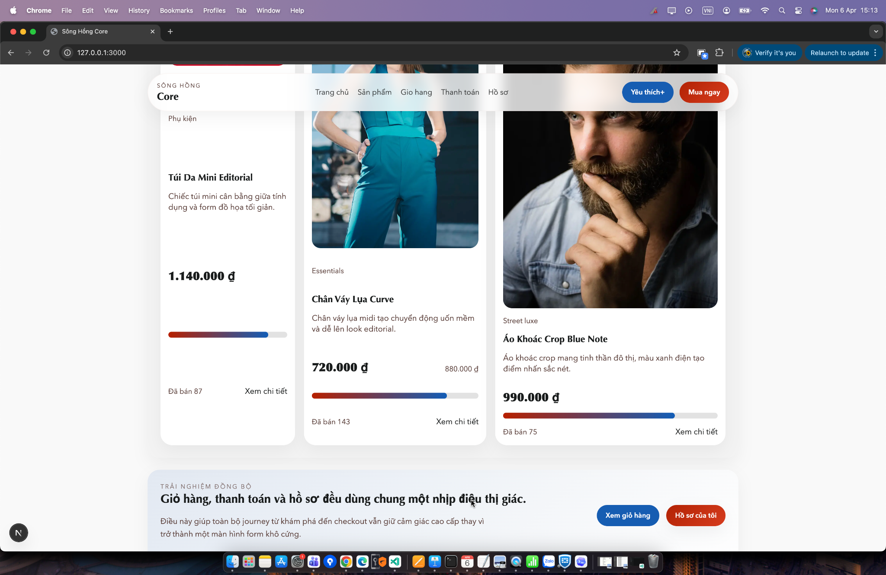
Demo:

Slide 15
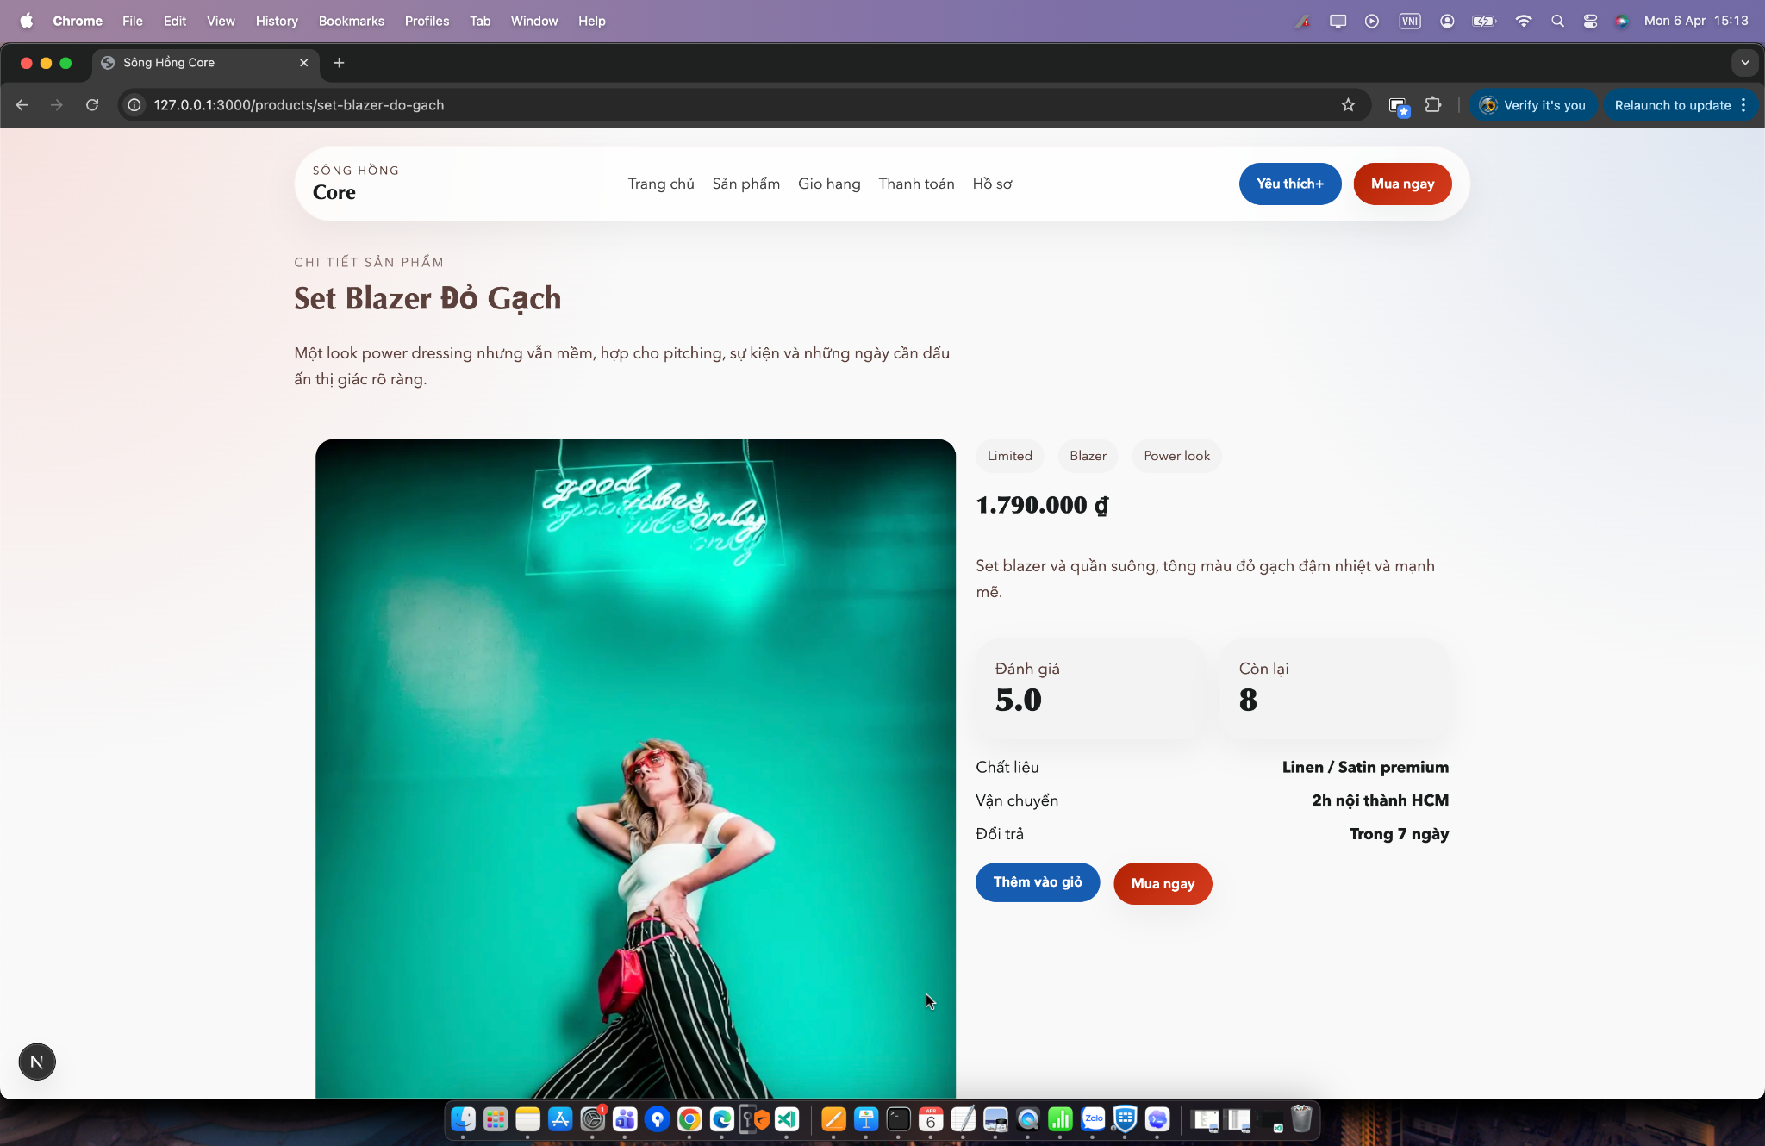
Demo:

Slide 16
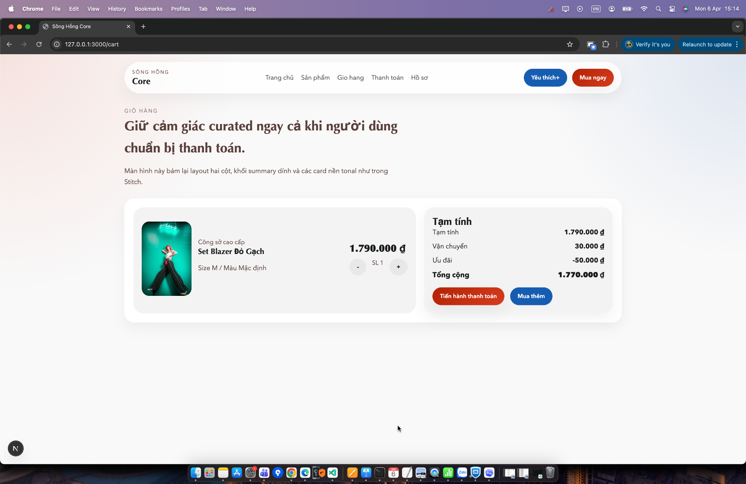
Demo:

Slide 17
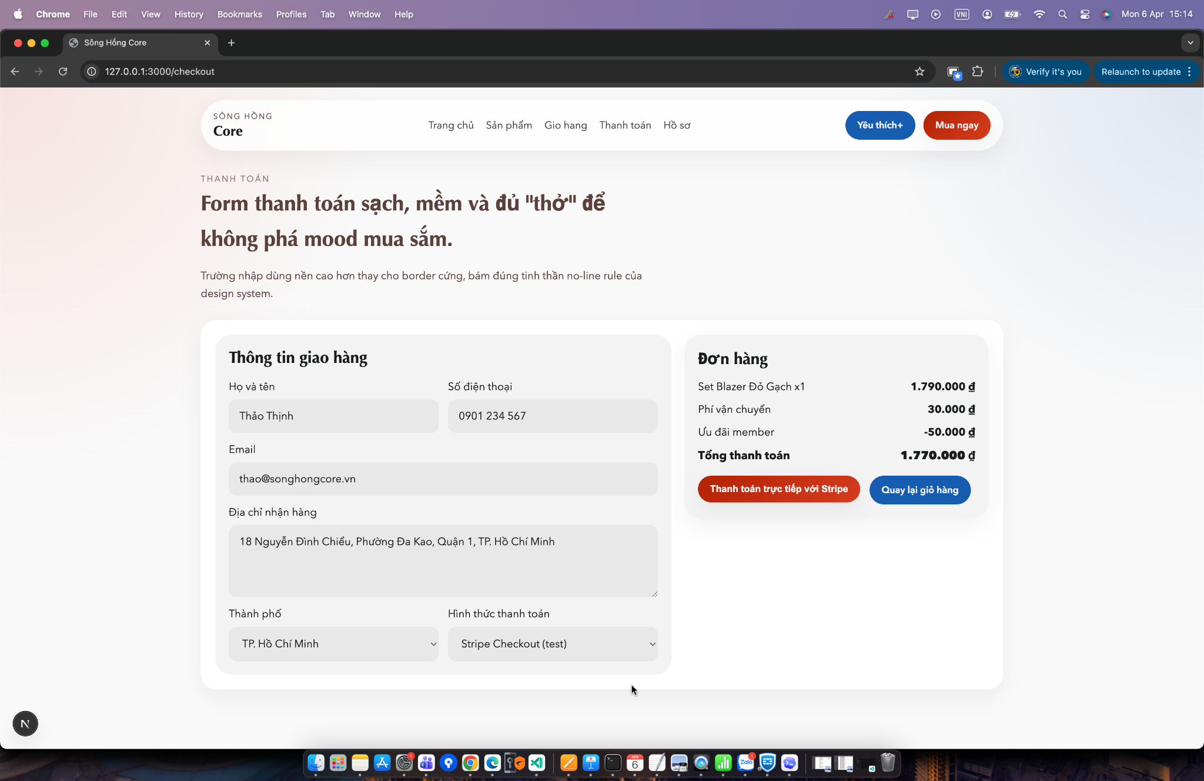
Demo:

Slide 18
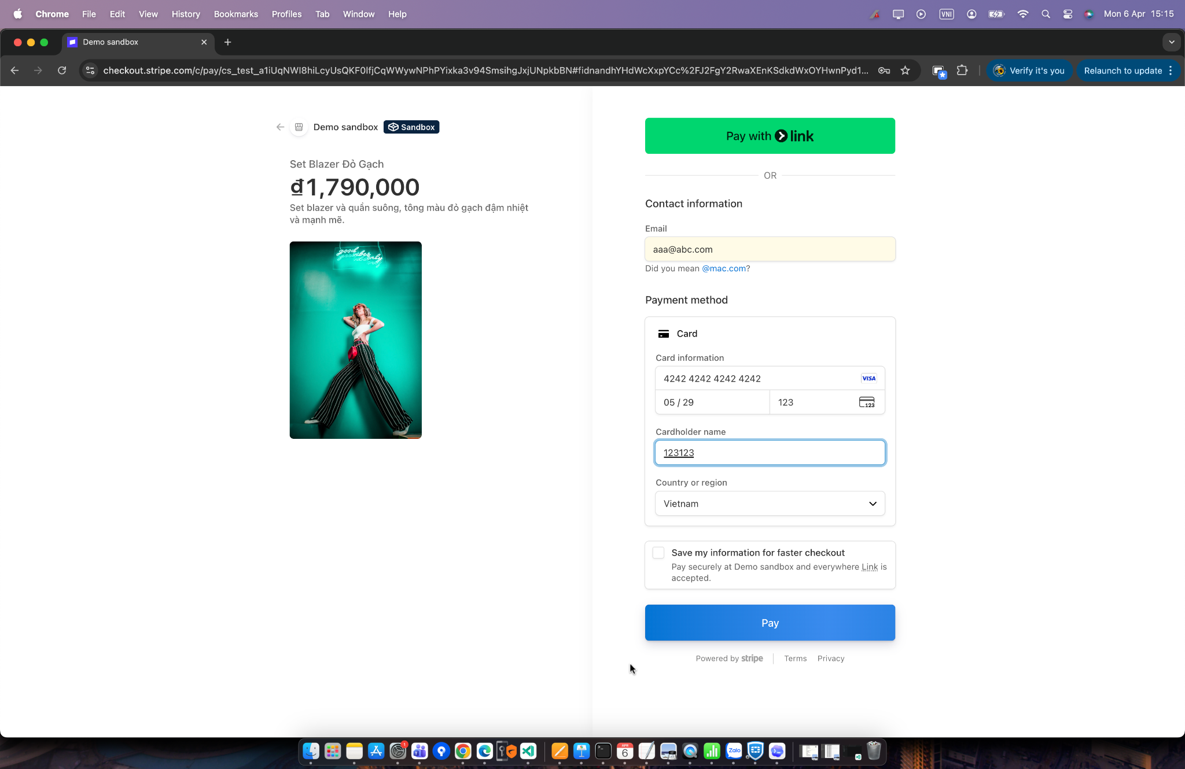
Demo:

Slide 19
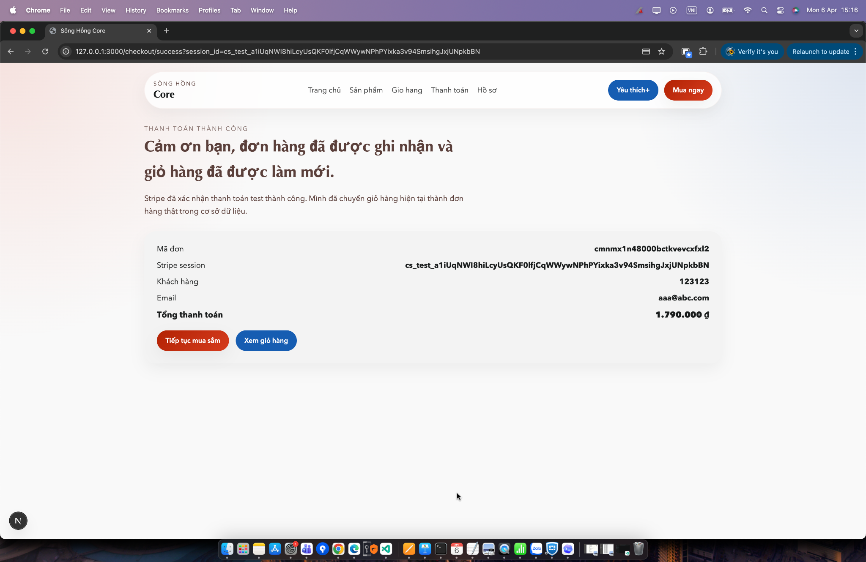
Demo:

Slide 20
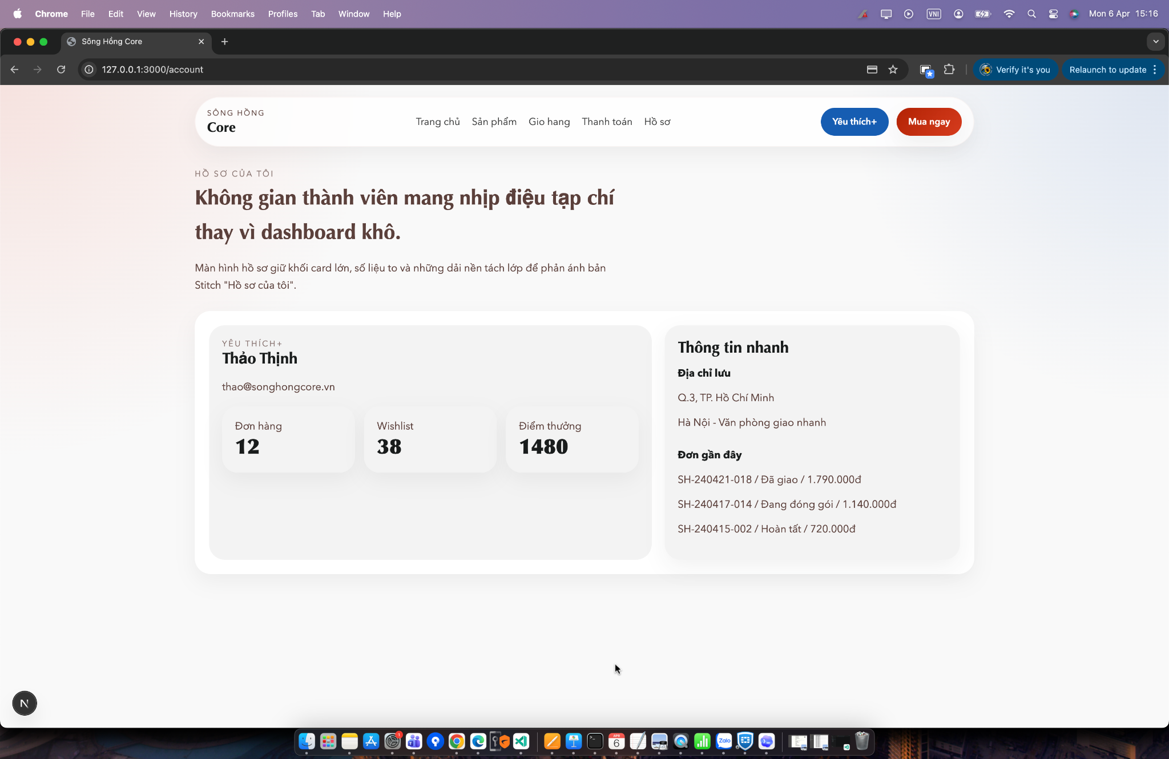
Demo:

